Slide 1

SmartPlant 3D Programming II
TSMP4002
Jim Hanson
Intergraph Corporation

Slide 2
Agenda
Monday - Tuesday
  Interference checking service
    Overview
    Interference Entity Data Model
    Processing Rules
    - Suppress interference between objects imported from CIMSteel
    - Assign a proper permission group for the interference object
    - Assign proper status for the interference object based on the interference type
    - Don’t report Insulation and insulation interferences when 2 pipes are connected by a
    component
  Tuesday - Friday
    Equipment Data Model (Smart Occurrence)
    Symbol Definition and Custom Assembly Definition
    Nozzle Place Holders
    Equipment Custom Assembly Definition using primitive shapes and control points
    Equipment Custom Assembly Definition using equipment components
    Equipment Custom Assembly Definition using other SP3D objects

Slide 3
Interference Service - Overview
Two methods:
  Server (Database Detect)
    Run on a separate IFC machine as a windows service Look for all interferences for the entire model
    Production check
  Client (Local Detect)
    Local to a session (what you see in your workspace)
    Simple / dynamic
    Help the designer in real time
    No database record
LOCAL
APPLICATION
UPDATE
DESIGN
CHANGES
PERIODIC
QUERY
CHANGES
PERIODIC
REFRESH
DISPLAY
DATABASE
SERVER-BASED
RULES
Processing Rule
IJDInterferenceRule
UPDATE
RESULTS

Slide 4
Interference Service - Overview
Database Detect | Local Detect
Runs all the time (System Admin. choice) | Works only within the current session
Minimizes impact on users and improves performance | Provides immediate graphical feedback (works in a dynamic mode)
Creates persistent interferences that are stored in the model database | Shows interferences when the pointer is idle for a brief amount of time; based on a hesitation approach
Based on administrator settings (controlled by permission groups) | Based on individual user settings
Provides feed back on how much has been checked | Checks only created and modified items
Users can visualize the interferences (persistent items) | Clears dynamic interferences after refreshing workspace
© 2007. Intergraph Corporation. All Rights Reserved.

Slide 5
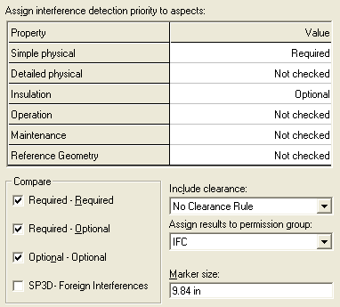
Interference Service - Overview
Three type of checking (based on the object aspects):
  Required (Hard)
  Optional (Soft)
  Not Checked
Can process:
  Required – Required (Hard – Hard)
  Required – Optional (Hard – Soft)
  Optional – Optional (Soft – Soft)
  SP3D - Foreign Interferences
A clearance can be used
© 2007. Intergraph Corporation. All Rights Reserved.

Slide 6
Interference Service - Overview
  Permission Requirements:
  Only an user who is Plant Administrator (Full Control on a plant) can start and stop IFC process
  Create a permission group where results will be assigned (IFC PG)
  Grant Write permission or higher to the Plant Administrator login on IFC PG
  Administrator should have at least Read permission in all other permission groups
  Configure the IFC Windows Service to utilize the Plant Administrator Login, e.g. domain\sp3dadmin. If possible use login with password not required to change as often as corporate users’
© 2007. Intergraph Corporation. All Rights Reserved.

Slide 7
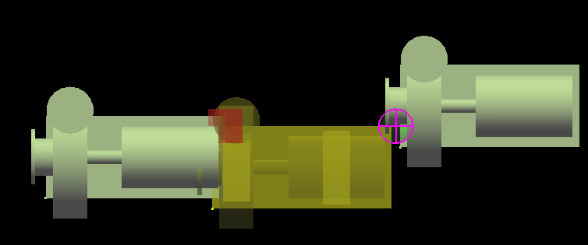
Interference Service - Overview
  Interference objects:
  Any persistent interference detected by the Database Detect process appears as a sphere
  Interference detected by the Local Detect process appears as a box
Local Detect
Database Detect
© 2007. Intergraph Corporation. All Rights Reserved.

Slide 8
Interference Service - Overview
The system administrator sets up the background IFC settings at the beginning of the project including configuring the Windows Service.
If the system administrator want to change any settings for the background interference during the project execution, then all existing interferences will be deleted including any approvals and notes, and the background interference checking must be restarted. This ensures a recheck of all objects with the new settings for IFC.
© 2007. Intergraph Corporation. All Rights Reserved.

Slide 9
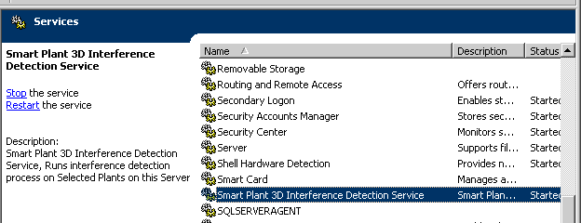
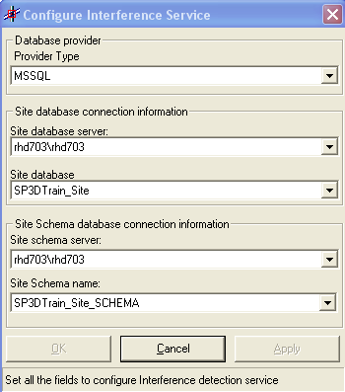
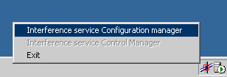
Service Settings
Interference Service - Overview
© 2007. Intergraph Corporation. All Rights Reserved.

Slide 10
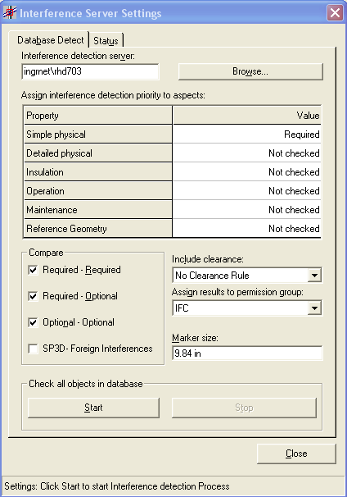
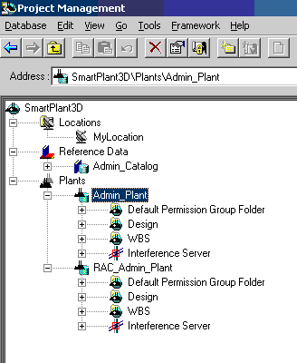
Interference Service - Overview
© 2007. Intergraph Corporation. All Rights Reserved.

Slide 11
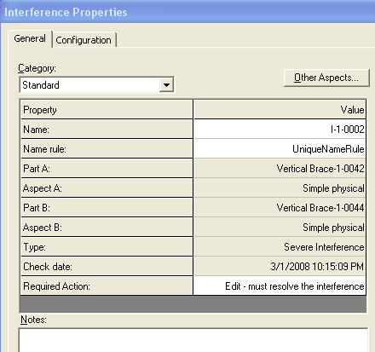
Interference Service - Overview
Interference Check is available in all Task (Tools → Check Interference)
Very simple and intuitive GUI
Ribbon bar includes:
  Settings
  Visualization
  Review & approval
© 2007. Intergraph Corporation. All Rights Reserved.

Slide 12
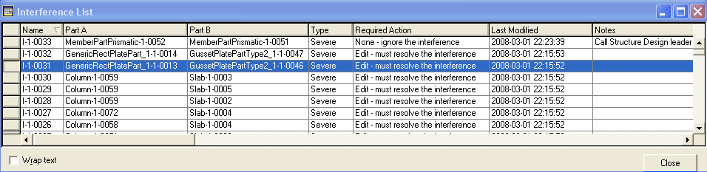
Interference Service - Overview
  Interference List Dialog Box
  - Resizable
  - Sort the listed interferences by Columns
  Highlight an interference in the workspace
  Double Click Interference entry to access property page for the interference
  Copy/Paste functionality from list to Excel
© 2007. Intergraph Corporation. All Rights Reserved.

Slide 13
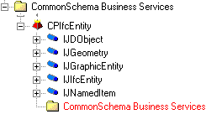
IFC Entity Data Model
CPIfcEntity
Package
Class
Interface

Slide 14
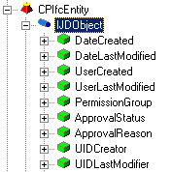
IFC Entity Data Model
Generic Object interfaces
IJDObject interface is a required interface for almost all objects. This interface provides access to the permission group for the object, the status, name of the user who created and last modified the object and the date and time for creation and last modification.
Class
Interface
Property

Slide 15
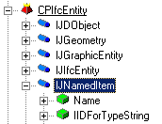
IFC Entity Data Model
Generic Object interfaces
IJNamedItem interface provides the name property and a type string for all named objects. This interface is used by any component that needs the name of an object as well as by components that need to display a simple type string for an object.

Slide 16
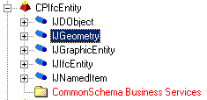
IFC Entity Data Model
Geometry interfaces
IJGeometry interface is required if the BO has geometry
IJGraphicEntity interface is required if the BO is displayable

Slide 17
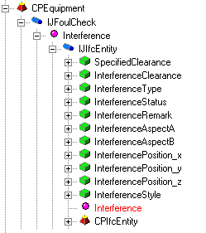
IJFoulCheck
IJFoulCheck is the basic interface used by Interference Engine to determine if the object implementing it collides with other objects that implement it.

Slide 18
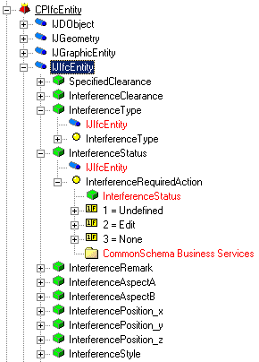
IFC Entity Data Model
Interference Interface
IJIfcEntity interface keeps track of all the interference properties created by the object.
Property
Codelist

Slide 19
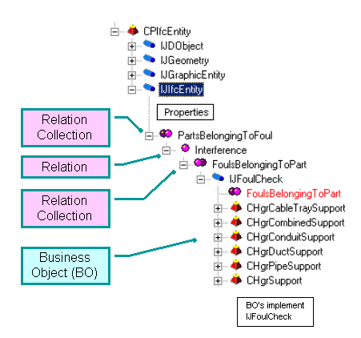
IFC Entity Data Model
Interference Relationship
BO’s implement the IJFoulCheck interface which is used to identify which objects should be checked for interferences with other object.
IJFoulCheck has a relation with the actual interference object's interface.

Slide 20
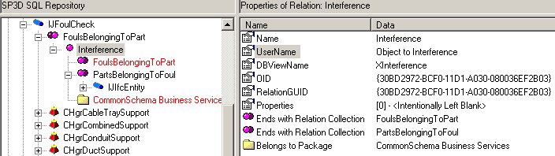
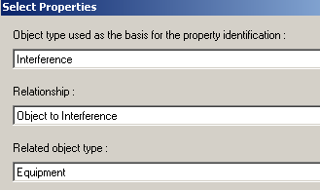
IFC Entity Data Model
Interference Relationship

Slide 21
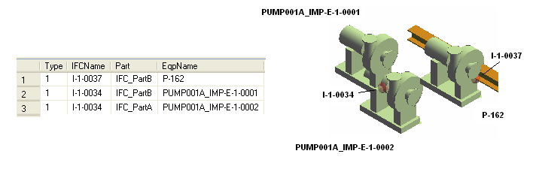
IFC Entity Data Model
Example: List all persistent interferences created by equipment objects
Select x1.FoulType as Type, x2.ItemName as IFCName,
x3.RelationName as Part, x5.ItemName as EqpName
from JIfcEntity x1
JOIN JNamedItem x2 on x2.oid = x1.oid
JOIN XInterference x3 on x3.oidorigin = x1.oid
JOIN JEquipment x4 on x4.oid = x3.oidDestination
JOIN JNamedItem x5 on x5.oid = x4.oid
Notes:
Select x1.FoulType as Type,
x2.ItemName as IFCName,
x3.RelationName as Part,
x5.ItemName as Name
from JIfcEntity x1
JOIN JNamedItem x2 on x2.oid = x1.oid
JOIN XInterference x3 on x3.oidorigin = x1.oid
JOIN SPSSlabEntity x4 on x4.oid = x3.oidDestination
JOIN JNamedItem x5 on x5.oid = x4.oid

Slide 22
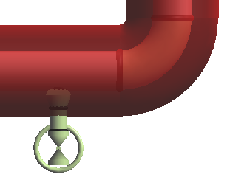
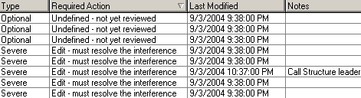
Interference Processing Rule
Customized component that allows users to define rules that automatically set properties on the Interference objects during creation and modification or to decide whether the Interference objects need to be persisted in the Database.

Slide 23
Interference Processing Rule
The Interference Processing rule is a Visual Basic component
Implements
- IJDInterferencePrePrcsrRule
- IJDInterferenceRule
Processing:
  Call at Creation - Create Interference method
  Call at Modification of existing interference - Modify Interference method
  Aspect Control - Get valid physical representation method
ProcessorRule
ProcessObject()
CreateInterference()
ModifyInterference()
GetValidPhysicalRepresentation()
COM
Interface

Slide 24
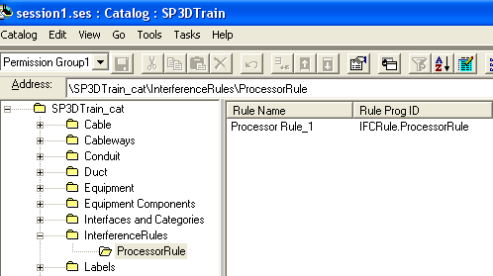
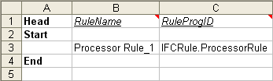
Interference Processing Rule
The Interference processing rule program is located at
<Install Directory>\Programming\ExampleCode\Rules\InterferenceRules

Slide 25
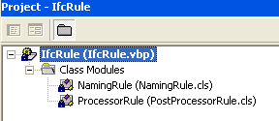
Interference Processing Rule
Processor Rule Module includes:
Private Sub Class_Initialize()
Private Sub Class_Terminate()
Function IJDInterferencePrePrcsrRule_ProcessObject()
Function IJDInterferenceRule_CreateInterference()
Sub IJDInterferenceRule_ModifyInterference()
Function IJDInterferenceRule_GetValidPhysicalRepresentation()

Slide 26
Interference Pre Processing Rule
Pre Processor Rule Module
This Rule will be called by interference service after it updates the range of the object. The object under processing and the Object type are sent as arguments and this rule returns True or False value. Based on this the object is either ignored or considered further.
Private Function IJDInterferencePrePrcsrRule_ProcessObject(ByVal pObject As Object, ByVal strObjectType As String) As Boolean
On Error GoTo ErrorHandler
IJDInterferencePrePrcsrRule_ProcessObject = True
‘ Insert your code
Exit Function
ErrorHandler:
Err.Clear
IJDInterferencePrePrcsrRule_ProcessObject = True
End Function

Slide 27
Interference Pre Processing Rule
Example:
Private Function IJDInterferencePrePrcsrRule_ProcessObject(ByVal pObject As Object, ByVal strObjectType As String) As Boolean
On Error GoTo ErrorHandler
IJDInterferencePrePrcsrRule_ProcessObject = True
‘Ignore objects based on the ObjectType.
If strObjectType Like "Plate System" Then
IJDInterferencePrePrcsrRule_ProcessObject = False
End If
Exit Function
ErrorHandler:
Err.Clear
IJDInterferencePrePrcsrRule_ProcessObject = True
End Function

Slide 28
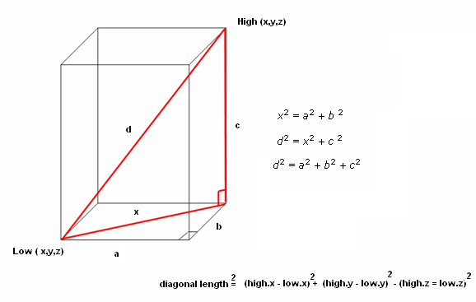
Interference Pre Processing Rule
Example:
Ignore objects based on their range extents

Slide 29
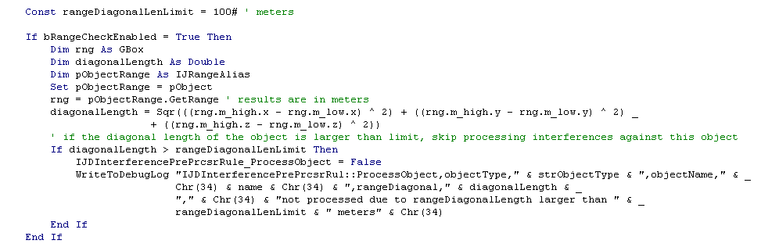
Interference Pre Processing Rule
Example:
Ignore objects based on their range extents

Slide 30
Interference Post Processing Rule
Processor Rule Module includes:
Four example rules:
Suppress interference between objects imported from CIMSteel
Assign a proper permission group for the interference object based on the colliding object’s ranking
Assign proper status for the interference object based on the interference type
Don’t report Insulation and insulation interferences when 2 pipes are connected by a component
Additional routines to support the example rules
  Private Sub AssignIFCPermissionGroup()
  Private Function GetPermissionGroupIndex()
  Private Function IsConnectedbyIntermediate()
  Private Function ConvertPGNameToNumber()
  Private Function GetAspectName()
  Private Function GetAspectCode()
  Private Function Distance()
  Private Function GetObjectIdentifyer()
  Private Function AreBothImportedObjects()
  Private Function GetResourceManager()

Slide 31
Interference Post Processing Rule
Create Interference method
This method gets triggered just after Interference process detects an Interference and just before persisting the same to the Database.
  Decide whether the Interference should be persisted or not in the Database.
  Initialize the interference properties automatically
    Permission Group
    Remarks
    Status (Action Required)

Slide 32
Processing Rule - Creation
Create Interference method
Example Rule 1: Suppress interference between objects imported from CIMSteel or from Tribon
If (AreBothImportedObjects(pParent1, pParent2)) Then
IJDInterferenceRule_CreateInterference = False
Exit Function
End If
pParent1[in] First Parent participating in Collision
pParent2[in] Second Parent participating in Collision
Imported Tribon objects support "IJImportedStructureItem"and "IJDImpPlate" interface
Imported CIMSteel (CIS/2) objects support “IJStructEDIData” interface
Tribon is a shipbuilding CAD/CAM program

Slide 33
Processing Rule - Creation
Create Interference method
Example Rule 2: Assign a proper permission group for the interference object based on the colliding object’s ranking.
If IfcType = IfcServerInterference Then
AssignIFCPermissionGroup pInterferenceObj, strParentType1, strParentType2
End If
pInterferenceObj[in] Pointer to IJIfcEntity
strParentType1[in] Type of first Parent participating in Collision
strParentType2[in] Type of second Parent participating in Collision

Slide 34
Processing Rule - Creation
Rule 2 (Example)
GroupIndex=0 Supports or Routes or Eqp objects
GroupIndex=1 Structure objects
GroupIndex=2 Interference Volumes
"IFC Group1“ Equipment & Piping users
"IFC Group2“ Structure users
"IFC Group3“ Interference volume users
When an interference happens with 2 different objects, Interference is recorded in the lowest rank (GroupIndex) of interfering objects. Therefore people who are in charge of the same will correct them accordingly.

Slide 35
Processing Rule - Creation
Rule 2 (Example)
Class_Initialize()
ReDim m_strPermissionGroups(3) As String
m_strPermissionGroups(0) = "IFC Group1“ (Supports + Routes + Eqp objects)
m_strPermissionGroups(1) = "IFC Group2“ (Structure objects)
m_strPermissionGroups(2) = "IFC Group3“ (Interference Volumes)

Slide 36
Processing Rule - Creation
Function GetPermissionGroupIndex()
Select Case (strParentType)
Case "Pipe Supports", "Cable Tray Supports", "Duct Supports"
GetPermissionGroupIndex = 0
Case "Conduits“, "Cable Tray Components", "Cableway Straight", "Cable Trays",
"Pipes", "Piping Welds", "Piping Components", "Piping Instruments", _
"Piping Specialty Items“, "Equipment“, "Cableway Turn“, "Cableway Along Leg“, _
"HVAC Components", "Ducts"
GetPermissionGroupIndex = 0
Case "Member Part Linear", "Slab", "Footing", "Stairs", "Ladders", "Handrails“ _
"Member Part Curve", "Equipment Foundation"
GetPermissionGroupIndex = 1
Case "Interference Volumes"
GetPermissionGroupIndex = 2
Case Default GetPermissionGroupIndex = -1
End Select

Slide 37
Processing Rule - Creation
Private Sub AssignIFCPermissionGroup(ByVal pNewInterference As IJIfcEntity,
ByVal strParentType1 As String, ByVal , strParentType2 As String)
PGIndexObj1 = GetPermissionGroupIndex(strParentType1)
PGIndexObj2 = GetPermissionGroupIndex(strParentType2)
If PGIndexObj1 < PGIndexObj2 Then
strInterferencePG = m_strPermissionGroups(PGIndexObj1)
Else
strInterferencePG = m_strPermissionGroups(PGIndexObj2)
End If
Set pObject = pNewInterference
nPGNumber = ConvertPGNameToNumber(strInterferencePG)
pObject.PermissionGroup = nPGNumber
Set pObject = Nothing

Slide 38
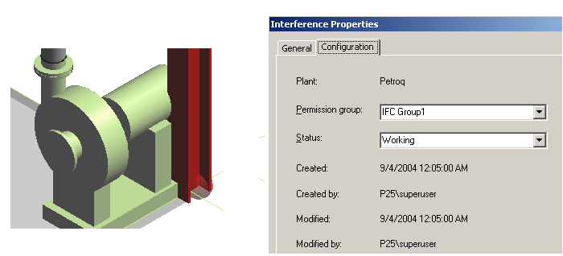
Processing Rule - Creation
Rule 2(Example)
Equipment collides with Member Part Prismatic

Slide 39

Processing Rule - Creation
Create Interference method
Example Rule 3: Assign proper status for the interference object based on the interference type.
If IfcType = IfcServerInterference Then
If pInterferenceObj.InterferenceType = ftSevereFoul Then
pInterferenceObj.InterferenceStatus = fsUnacceptableFoul
ElseIf pInterferenceObj.InterferenceType = ftOptionalFoul Then
pInterferenceObj.InterferenceStatus = fsUndefinedFoul
ElseIf pInterferenceObj.InterferenceType = ftClearanceFoul Then
pInterferenceObj.InterferenceStatus = fsAcceptableFoul
Else 'It is a Bad part foul
pInterferenceObj.InterferenceStatus = fsUnacceptableFoul
End If
End If

Slide 40
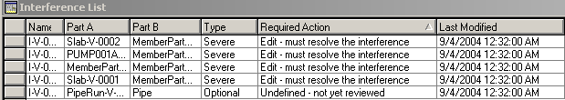
Processing Rule - Creation
Rule 3 (Example)

Slide 41
Processing Rule - Modification
Modification Interference method
Rule 1: Default implementation just resetting the status and add a note.
Dim strAppendNotes As String
Dim strexistingNotes As String
strAppendNotes = " Changes did not remove the Interference"
If IfcType = IfcServerInterference Then
Select Case (pOldInterference.InterferenceType)
Case ftSevereFoul
pOldInterference.InterferenceStatus = fsUnacceptableFoul
Case ftOptionalFoul
pOldInterference.InterferenceStatus = fsUndefinedFoul
Case ftClearanceFoul
pOldInterference.InterferenceStatus = fsAcceptableFoul
Case ftBadPartFoul
pOldInterference.InterferenceStatus = fsUndefinedFoul
End Select
If Not (strAppendNotes Like "") Then
strexistingNotes = pOldInterference.InterferenceRemark
strexistingNotes = strexistingNotes + strAppendNotes
pOldInterference.InterferenceRemark = strexistingNotes
End If
End If

Slide 42
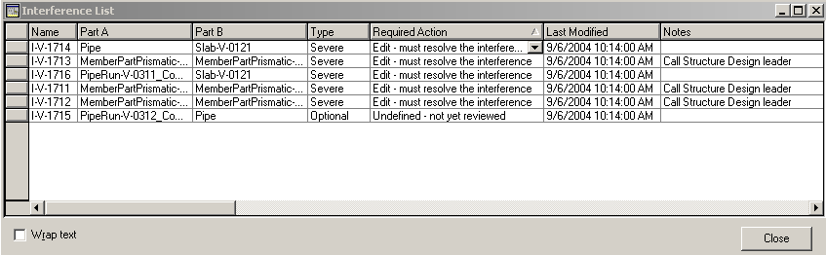
Processing Rule - Creation
Training Example
Add notes for the interference object based on the object type
Dim strNotes As String
strNotes = ""
If IfcType = IfcServerInterference Then
If strParentType1 Like "Member Part Linear" And _
strParentType2 Like "Member Part Linear" Then
strNotes = "Call Structure Design leader"
pInterferenceObj.InterferenceRemark = strNotes
End If
End If
Notes:
'------------------------------Set remark property -------------------------------------------------------------------
Dim strNotes As String
strNotes = ""
If IfcType = IfcServerInterference Then
If strParentType1 Like "Member Part Prismatic" And _
strParentType2 Like "Member Part Prismatic" Then
strNotes = "Call Structure Design leader"
End If
If Not (strNotes Like "") Then
pInterferenceObj.InterferenceRemark = strNotes
End If
End If

Slide 43
Processing Rule - Creation
Training Example
Don’t report handrails-to-slab collisions
If IfcType = IfcServerInterference Then
If HandrailClashGrating(strParentType1, strParentType2, pParent1, pParent2) Then
IJDInterferenceRule_CreateInterference = False
Exit Function
End If
End If
Notes:
'--------------- Do not create Interference object when both colliding objects are slabs -----------------------------
If IfcType = IfcServerInterference Then
If strParentType1 Like "Slabs" And strParentType2 Like "Slabs" Then
IJDInterferenceRule_CreateInterference = False
Exit Function
End If
End If

Slide 44
Processing Rule - Creation
The algorithm of this rule is as follows:
When ObjectType1 = “Slab” and ObjectType2 = “HandRail”
Get the slab type using the relation service
Get the part number of the slab using the attribute service
If InStr(slabtype,”Grating”) is true
Then, create the interference
When ObjectType1 = “Handrail” and ObjectType2 = “Slab”
Get the slab type using the relation service
Get the part number of the slab using the attribute service
If InStr(slabtype,”Grating”) is true
Then, create the interference
Notes:
Private Function IsNipconnectedtoInsPipe(ByVal Obj1 As Object, _
ByVal Obj2 As Object) As Boolean
On Error GoTo ErrorHandler
IsNipconnectedtoInsPipe = False
Dim oRelationHelper As IMSRelation.DRelationHelper
Dim oCollection As IMSRelation.DCollectionHelper
Set oRelationHelper = Obj1
Dim oRelatedObject As IJDPipeComponent
Set oCollection = oRelationHelper.CollectionRelations("IJPartOcc", "Part")
Set oRelatedObject = oCollection.Item(1)
Dim oAttributes As IJDAttributes
Set oAttributes = oRelatedObject
Dim iCommodityType As Long
iCommodityType = _
oAttributes.CollectionOfAttributes("IJDPipeComponent").Item("CommodityType").Value
If iCommodityType = 1105 Then
If IsConnectedbyIntermediate(Obj1, Obj2) = True Then
IsNipconnectedtoInsPipe = True
End If
End If
Set oRelationHelper = Nothing
Set oCollection = Nothing
Set oRelatedObject = Nothing
Set oAttributes = Nothing
Exit Function
ErrorHandler:
Debug.Assert False
Set oRelationHelper = Nothing
Set oCollection = Nothing
Set oRelatedObject = Nothing
Set oAttributes = Nothing
End Function

Slide 45
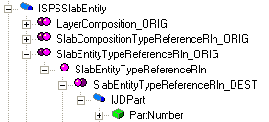
Processing Rule - Creation
Relationship
The following picture shows an example. This defines a relationship of type SlabEntityReferenceRln between the interface ISPSSlabEntity, origin of the relationship, and the interface IJDPart for a destination.
  The interface origin of the relationship
  The interface destination of the relationship
  A relationship type
Use the relation helper to access the part of the colliding object
Use the Attribute Helper to get the part number of the slab
Notes:
Private Function IsNipconnectedtoInsPipe(ByVal Obj1 As Object, _
ByVal Obj2 As Object) As Boolean
On Error GoTo ErrorHandler
IsNipconnectedtoInsPipe = False
Dim oRelationHelper As IMSRelation.DRelationHelper
Dim oCollection As IMSRelation.DCollectionHelper
Set oRelationHelper = Obj1
Dim oRelatedObject As IJDPipeComponent
Set oCollection = oRelationHelper.CollectionRelations("IJPartOcc", "Part")
Set oRelatedObject = oCollection.Item(1)
Dim oAttributes As IJDAttributes
Set oAttributes = oRelatedObject
Dim iCommodityType As Long
iCommodityType = _
oAttributes.CollectionOfAttributes("IJDPipeComponent").Item("CommodityType").Value
If iCommodityType = 1105 Then
If IsConnectedbyIntermediate(Obj1, Obj2) = True Then
IsNipconnectedtoInsPipe = True
End If
End If
Set oRelationHelper = Nothing
Set oCollection = Nothing
Set oRelatedObject = Nothing
Set oAttributes = Nothing
Exit Function
ErrorHandler:
Debug.Assert False
Set oRelationHelper = Nothing
Set oCollection = Nothing
Set oRelatedObject = Nothing
Set oAttributes = Nothing
End Function

Slide 46
Processing Rule - Creation
Relation Helper
CollectionRelations(interfaceID, collectionName As String) As Object
Set oRelationHelper = Obj1
Dim oAttrbs As IJDAttributes
Set oCollection = oRelationHelper.CollectionRelations("ISPSSlabEntity",“SlabEntityTypeReferenceRln_ORIG")
Set oAttrbs = oCollection.Item(1)
slabtype = oAttrbs.CollectionOfAttributes("IJDPart").Item("PartNumber").Value
Obj1
Interface
Relation Collection
Related Object
Notes:
Private Function IsNipconnectedtoInsPipe(ByVal Obj1 As Object, _
ByVal Obj2 As Object) As Boolean
On Error GoTo ErrorHandler
IsNipconnectedtoInsPipe = False
Dim oRelationHelper As IMSRelation.DRelationHelper
Dim oCollection As IMSRelation.DCollectionHelper
Set oRelationHelper = Obj1
Dim oRelatedObject As IJDPipeComponent
Set oCollection = oRelationHelper.CollectionRelations("IJPartOcc", "Part")
Set oRelatedObject = oCollection.Item(1)
Dim oAttributes As IJDAttributes
Set oAttributes = oRelatedObject
Dim iCommodityType As Long
iCommodityType = _
oAttributes.CollectionOfAttributes("IJDPipeComponent").Item("CommodityType").Value
If iCommodityType = 1105 Then
If IsConnectedbyIntermediate(Obj1, Obj2) = True Then
IsNipconnectedtoInsPipe = True
End If
End If
Set oRelationHelper = Nothing
Set oCollection = Nothing
Set oRelatedObject = Nothing
Set oAttributes = Nothing
Exit Function
ErrorHandler:
Debug.Assert False
Set oRelationHelper = Nothing
Set oCollection = Nothing
Set oRelatedObject = Nothing
Set oAttributes = Nothing
End Function

Slide 47
Processing Rule - Creation
Training Example
Don’t report interferences when colliding objects belong to a Test Permission Group
If IfcType = IfcServerInterference Then
If objectBelongToPG("TESTPG", pParent1, pParent2) Then
IJDInterferenceRule_CreateInterference = False
Exit Function
End If
End If
Notes:
' Exclude colliding objects that belongs to a permission group like Test Permission Group
' This rule will allow user to place preliminary objects so that the interference process will not
' persisted any interference objects.
If IfcType = IfcServerInterference Then
If IfParentBelongtoTestPG(pParent1, pParent2) Then
IJDInterferenceRule_CreateInterference = False
End If
End If

Slide 48
Processing Rule - Creation
objectBelongToPG()
Private Function objectBelongToPG(UPPERCASE_pgName_substring As String _
, ByVal pParent1 As Object _
, ByVal pParent2 As Object _
) As Boolean
On Error GoTo ErrHndlr
objectBelongToPG = False
Dim pNum1 As Long, pNum2 As Long
Dim strPgName1 As String, strPgName2 As String
Dim pObject1 As IJDObject
Dim pObject2 As IJDObject
Set pObject1 = pParent1
Set pObject2 = pParent2
pNum1 = pObject1.PermissionGroup
pNum2 = pObject2.PermissionGroup
strPgName1 = ConvertPGNumberToName(pNum1)
strPgName2 = ConvertPGNumberToName(pNum2)
If InStr(UCase(strPgName1), UPPERCASE_pgName_substring) > 0 Or _
InStr(UCase(strPgName2), UPPERCASE_pgName_substring) > 0 Then
objectBelongToPG = True
Exit Function
End If
Notes:
Private Function IfParentBelongtoTestPG(ByVal pParent1 As Object, _
ByVal pParent2 As Object) As Boolean
On Error GoTo ErrHndlr
IfParentBelongtoTestPG = False
Dim pNum1, pNum2 As Long
Dim strPgName1, strPgName2 As String
Dim pObject1 As IJDObject
Dim pObject2 As IJDObject
Set pObject1 = pParent1
Set pObject2 = pParent2
pNum1 = pObject1.PermissionGroup
pNum2 = pObject2.PermissionGroup
strPgName1 = ConvertPGNumberToName(pNum1)
strPgName2 = ConvertPGNumberToName(pNum2)
If strPgName1 Like "Test Permission Group" Or _
strPgName2 Like "Test Permission Group" Then
IfParentBelongtoTestPG = True
Exit Function
End If
Set pObject1 = Nothing
Set pObject2 = Nothing
Exit Function
ErrHndlr:
Debug.Assert False
Set pObject1 = Nothing
Set pObject2 = Nothing
End Function

Slide 49
Processing Rule - Creation
ConvertPGNumberToName()
Private Function ConvertPGNumberToName(ByVal PGnum As Long) As String
On Error GoTo ErrHndlr
Dim PGID, count As Long
Dim pgName As String
Dim i As Long
Dim oMidCtx As IJMiddleContext
Dim oDBTypeConfig As IJDBTypeConfiguration
Dim oDataBaseConfig As IJDataBaseConfiguration
Dim oACConfig As IJAccessControlConfiguration
Dim oAccessControl As IJAccessControl
ConvertPGNumberToName = "“
Set oDBTypeConfig = New DBTypeConfiguration
Set oDataBaseConfig = New DataBaseConfiguration
Set oACConfig = New AccessControlConfiguration
Set oMidCtx = New GSCADMiddleContext
oMidCtx.GetConfigurationTablesFromMiddle oDBTypeConfig, oDataBaseConfig, oACConfig
Set oAccessControl = oACConfig.AccessControl
count = oACConfig.NumberConditionIDs
For i = 1 To count
oACConfig.GetConditionIDByIndex i, pgName, PGID
If PGID = PGnum Then
ConvertPGNumberToName = pgName
Exit Function
End If
Next i
Notes:
Private Function IfParentBelongtoTestPG(ByVal pParent1 As Object, _
ByVal pParent2 As Object) As Boolean
On Error GoTo ErrHndlr
IfParentBelongtoTestPG = False
Dim pNum1, pNum2 As Long
Dim strPgName1, strPgName2 As String
Dim pObject1 As IJDObject
Dim pObject2 As IJDObject
Set pObject1 = pParent1
Set pObject2 = pParent2
pNum1 = pObject1.PermissionGroup
pNum2 = pObject2.PermissionGroup
strPgName1 = ConvertPGNumberToName(pNum1)
strPgName2 = ConvertPGNumberToName(pNum2)
If strPgName1 Like "Test Permission Group" Or _
strPgName2 Like "Test Permission Group" Then
IfParentBelongtoTestPG = True
Exit Function
End If
Set pObject1 = Nothing
Set pObject2 = Nothing
Exit Function
ErrHndlr:
Debug.Assert False
Set pObject1 = Nothing
Set pObject2 = Nothing
End Function

Slide 50

Processing Rule - Creation
Create Interference method
Example Rule 4: Don’t report Insulation and insulation interferences when 2 pipes are connected by a component.
When ObjectType1 = “Pipe part”
If Aspect1 = Aspect2 = Insulation. Then do the following logic
otherwise break and create an Interference.
Get connected Objects for Object1. --- List1.
For each object in List1
Get Connected objects, -- List2
For each Object in List2
If Object is Object 2 then
Both objects are connected through a middle object.
Break the loop
Endif
Loop for next object in List 2
Loop for next object in List 1
If the Objects are not connected through an intermediate object then
create the interference otherwise not.

Slide 51
Processing Rule - Creation
Rule 4 (Example)
If (strParentType1 <> strParentType2) Then
Exit Function
Else
If Not (strParentType1 Like "Pipes") Then
Exit Function
End If
If pInterferenceObj.InterferenceAspectA = pInterferenceObj.InterferenceAspectB Then
If GetAspectName(pInterferenceObj.InterferenceAspectA) Like "Insulation" Then
If IsConnectedbyIntermediate(pParent1, pParent2) = True Then
IJDInterferenceRule_CreateInterference = False
Exit Function
Else IJDInterferenceRule_CreateInterference = True
Exit Function
End If
End If
End If
End If

Slide 52
Processing Rule - Modification
Modification Interference method
  This rule gets triggered when Interference detection process is trying to modify an interference, because of the modification of the parts participating in the collision.
  Decide what to do when the parent(s) of an existing interference have been modified. Example:
    Change status
    Add Notes

Slide 53
Interference Post processing Rule
Get Valid Physical Representation Rule method
  If Interference process finds an object which has 2 physical representations, this rule will choose the proper representation to be used for that type of object.
Private Function IJDInterferenceRule_GetValidPhysicalRepresentation(ByVal strObjectType As String, ByVal SupportedPhysicalReps As Long) As Long
On Error GoTo ErrorHandler
'Kept a check for Pipe Supports as Detailed physical aspect Geometry is not good.
If ((strObjectType Like "Pipe Supports") Or (strObjectType Like "Duct Supports") Or (strObjectType Like "Cable Tray Supports")) Then
IJDInterferenceRule_GetValidPhysicalRepresentation = GetAspectCode("Simple physical")
Else
IJDInterferenceRule_GetValidPhysicalRepresentation = GetAspectCode("Detailed physical")
End If
Exit Function

Slide 54
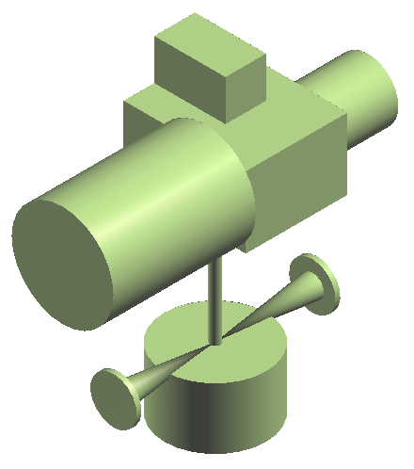
Overview
Part Occurrence Model (Part Class/Part Occurrence)
Nozzles are nested symbols and are defined as output of the piping symbols
Nozzle inputs come from the catalog part, which are used to create the nested nozzles
There is no direct way for the user to control the input values for the nozzles on the piping components except by changing the data in the excel sheets and re-bulk loading them in the catalog
Model DB
Catalog DB
.xls
Bulk-load
Part
Occurrence A1
MadeFrom
Class
Part
Occurrence A2
Part1
Part2
Symbol
Code
Symbol
Definition

Slide 55
Overview
Smart Class/Smart Occurrence (Equipment Assembly)
Equipment adopts the Smart Occurrence behavior
Equipment is a custom assembly that contains members (nozzles, shapes, equipment components, structure objects, zone objects, etc..)
Catalog DB
Model DB
.xls
Bulk-load
Selection Root
SmartClass A
Selector
Code
Smart A1
Occurrence
SmartItem A1
Definition
Code
Parameter
Code
Child
SOtoSI_R
Child
Smart A2
Occurrence
SmartItem A2
Symbol
Code
Symbol
Definition

Slide 56
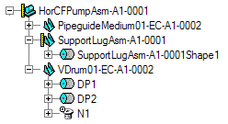
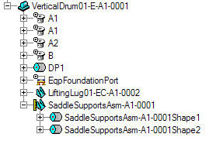
Overview
All nozzles become First Class Business Object with their own identity. They are not nested outputs of the symbol
Fusion of the two concepts: catalog and design equipment
- A catalog equipment simply becomes a programmatically
defined design equipment
- A catalog equipment can be designed once is placed
Designed Equipment Catalog Equipment
Designed Equipment Component
Equipment Component

Slide 57
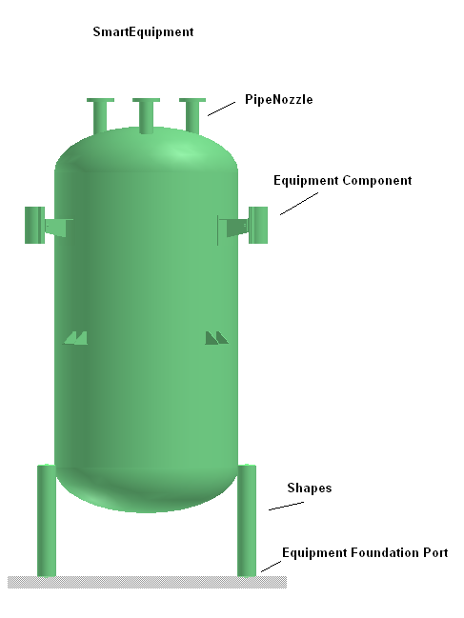
Equipment Data Model
Business Objects Defined in Equipment Application
  First Class Business Objects
  CPSmartEquipment
  CPEquipmentComponent
  CPShape
  CPPrismaticShape
  CPUAImportedShapeOcc
  CPPipeNozzle
  CPCableTrayNozzle
  CPConduitNozzle
  CPCableNozzle
  CPHvacNozzle
  CPEqpFoundationPort

Slide 58
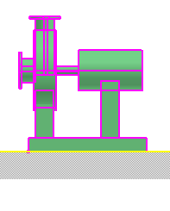
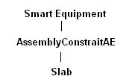
Equipment Data Model
Business Objects Defined in Equipment Application
  Non-First Class Business Objects
  CPAssemblyConstraintAE
  CPNozzleOrientation
  CPPipeNozzlePH
  CPCableTrayNozzlePH
  CPConduitNozzlePH
  CPCableNozzlePH
  CPHvacNozzlePH
  CPEqpFoundationPortPH
    Port Placeholder is a persistent object that holds the information about the actual port.

Slide 59
Equipment Data Model
MachinerySystem
Coordinate System
Smart Item
HasCSystem
HasEqpAsChild
SOtoSI_R
Smart Equipment
Occurrences
HasEqpComponents
<Pattern3MatePartRln>
Equipment Component
AssemblyConstraintAE
HasShapes
HasPorts
DistribPorts
Shapes
Pattern3MateSurfRln
Equipment Foundation Port
Route Ports
Surface

Slide 60
Equipment Assembly
The following items have driven the design of the smart occurrence behavior:
similitude with symbol : the pair custom assembly occurrence/definition is similar to the pair symbol occurrence/definition. The second one manages outputs, while the first manages members
no requirement on member : a member can be any object. There is no required interface. The member is created by the owner
member lifetime : the owner manages the life time of a member : when to create it and when to delete it
custom semantic on aggregator : the properties of the aggregator can be controlled at compute time
custom semantic on members : the properties of the members, in the context of the custom assembly, can also be controlled at compute time

Slide 61
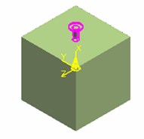
Equipment Assembly
Custom Assembly
Supports 2 primary programmable customizations (Rules)
  Definition – Required, specifies the members of the equipment assembly hierarchy and the customization rules
  Symbol – defines the graphic symbol of the aggregator (Equipment)
Smart
Occurrence
Selector
Code
Assembly
Parent
SmartClass A
SmartItem A1
Definition
Code
Port
Shape
SmartItem A2
Symbol
Code

Slide 62
Equipment Assembly
Custom Assembly Definition (CAD)
Object to be instantiated in the catalog database
A COM (VB/VC++) class
Implements
    Interfaces
    - IJDUserSymbolServices: initialize and instantiate the definition
    - IJEquipUserAttrMgmt: provide methods to control the member’s attributes
    Custom methods
      Controls some aspects of the smart equipment (Aggregator) itself
      Creates/Controls member objects

Slide 63
Equipment Assembly
Custom method
Call-back function specified by users to provide customizations
  Create objects
  Modify existing objects
  Create relationships between objects
Must be unique by name in implementing class
  CMConditional() – optional
  CMConstruct()
  CMFinalConstruct() - optional
  CMSetInputs() - optional
  CMEvaluate() – optional
  CMEvaluateGeometry()
  CMRelease() - optional
  CMCount() - optional

Slide 64
Workflow
Custom Assembly Definition
Initialized
Set definition
Manage aggregator
Call properties ‘custom methods
Call CMFinalConstruct
Aggregator Updated
Update Members
Evaluate CMConditional
Needed but does not exist
Not needed and
already created
Not needed and does not exist
Needed and exist
Delete member
Update member
Call CMSetInputs
Call member properties
‘custom methods
Create member
Call CMConstruct
Call CMFinalConstruct

Slide 65
Equipment Assembly
Visual Basic Project (.vbp) and Class Modules (.cls) files:
VB Project
Display graphics for the BO
Define objects to be created
Symbol Code
Definition Code
CPhysical
Geometry3D.bas
CInsulation
Geometry3DPH.bas
COperation
Geometry3DPH.bas: contains routines to create Nozzle placeholder. Example:
CreateNozzlePHWithLength(index, oPartFclt, m_OutputColl, oDir, CenterPos, parLength)

Slide 66
Equipment Assembly
Symbol Definition
Set the following information:
  Inputs: are entries that drive the graphic representation of the symbol
  Outputs: Graphics Output Description
  Representation(s): Description
  IJSymbolHelper
  This interface provides methods to help in creating the symbol definition. It provides the implementation of the IJDUserSymbolServices interface as well as provide support for declaring the inputs and outputs of the symbol.

Slide 67
Equipment Assembly
Custom Assembly Definition
Implements the interface IJDMemberDescriptions and IJDMemberDescription.
IJDMemberDescriptions: provides methods to manipulate the member collection
IJDMemberDescription: specify how the member of the smart occurrence is generated
Dim oMemberDescriptions As IJDMemberDescriptions
Dim oMemberDescription As IJDMemberDescription
Set oMemberDescription = Nothing
Set oMemberDescription = oMemberDescriptions.AddMember("NozzleN1", 1, "CMConstructNozzleN1", imsCOOKIE_ID_USS_LIB)
…..

Slide 68
Equipment Assembly
Custom Assembly Definition
….
oMemberDescription.SetCMFinalConstruct imsCOOKIE_ID_USS_LIB, "CMFinalConstructNozzleN1"
oMemberDescription.SetCMSetInputs imsCOOKIE_ID_USS_LIB, "CMSetInputsNozzleN1"
oMemberDescription.SetCMConditional imsCOOKIE_ID_USS_LIB, "CMConditionalNozzleN1"
oMemberDescription.SetCMCount imsCOOKIE_ID_USS_LIB, "CMCountNozzleN1"
oMemberDescription.SetCMRelease imsCOOKIE_ID_USS_LIB, "CMReleaseNozzleN1“

Slide 69
Equipment Assembly
Custom Assembly Definition
Implements the interface IJDPropertyDescriptions
IJDPropertyDescriptions: manipulate a property on a member
..
Set oPropertyDescriptions = Nothing
Set oPropertyDescriptions = oMemberDescription
oPropertyDescriptions.AddProperty "NozzleN1Properties", 1, IID_IJDATTRIBUTES, "CMEvaluateNozzleN1", imsCOOKIE_ID_USS_LIB
oPropertyDescriptions.AddProperty "NozzleN1GeometryProperties", 2, IID_IJDGEOMETRY, "CMEvaluateGeometryNozzleN1", imsCOOKIE_ID_USS_LIB
…

Slide 70
Custom method
CMConstruct_Xxxx()
Code to construct the child object
Sets input to the child object
Public Sub CMConstructNozzleN1(ByVal pMemberDescription As IJDMemberDescription, _
ByVal pResourceManager As IUnknown, ByRef pObject As Object)
Const METHOD = "CMConstructNozzleN1"
On Error GoTo ErrorHandler
'Create Nozzle
m_oEquipCADHelper.CreateNozzleFromPH pMemberDescription, pResourceManager, pObject, 1
Exit Sub
ErrorHandler:
HandleError MODULE, METHOD
End Sub

Slide 71
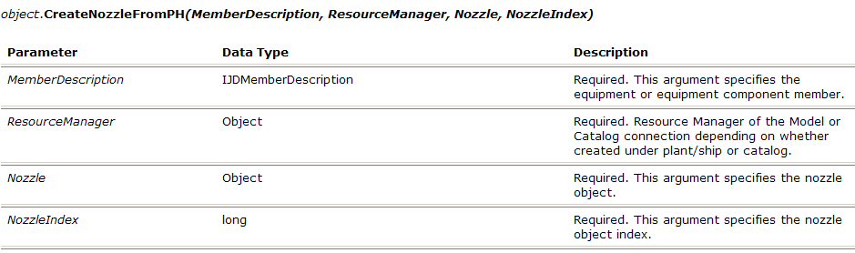
EquipCADHelper service
The Equipment Symbol CAD Helper service provides methods and properties to manage the custom assembly definition.
The CreateNozzleFromPH method creates a pipe nozzle from a nozzle placeholder defined in the equipment symbol.
m_oEquipCADHelper.CreateNozzleFromPH pMemberDescription, pResourceManager, pObject, 1

Slide 72
Custom method
CMConditional_Xxxx()
Evaluates a condition
Returns True Or False
If True, child object is constructed
Public Sub CMConditionalNozzleN1(ByVal pMemberDesc As IJDMemberDescription, ByRef IsNeeded As Boolean)
Const METHOD = "CMConditionalNozzleN1"
On Error GoTo ErrorHandler
IsNeeded = m_oEquipCADHelper.CheckMemberConditional(pMemberDesc)
Exit Sub
ErrorHandler:
HandleError MODULE, METHOD
End Sub

Slide 73
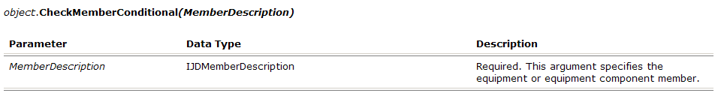
EquipCADHelper service
The Equipment Symbol CAD Helper service provides methods and properties to manage the custom assembly definition
The CheckMemberConditional method checks whether the member is conditional based on the CanBeDeleted flag in the MakeMemberDeletable method.
m_oEquipCADHelper.CheckMemberConditional(pMemberDesc)

Slide 74
Custom method
CMEvaluateGeometry_Xxxx()
Used for computing the child object.
Public Sub CMEvaluateGeometryNozzleN1(ByVal oPropertyDescription As IJDPropertyDescription, pObject As Object)
Const METHOD = "CMEvaluateGeometryNozzleN1"
On Error GoTo ErrorHandler
'Transform the nozzle so that it behaves like a rigid body inside the equipment
m_oEquipCADHelper.TransformNozzleWrtPH oPropertyDescription, pObject, 1
Exit Sub
ErrorHandler:
HandleError MODULE, METHOD
End Sub

Slide 75
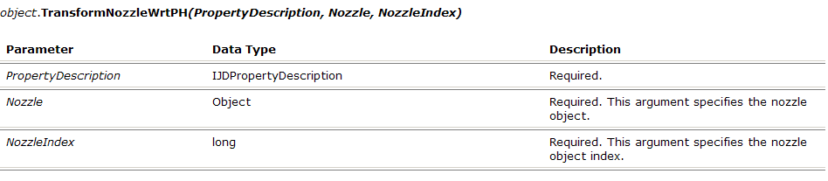
EquipCADHelper service
The Equipment Symbol CAD Helper service provides methods and properties to manage the custom assembly definition.
The TransformNozzleWrtPH method keeps the Nozzle, as a member, always positioned as the matching nozzle placeholder in the symbol.
This method prevents free transformation of the Nozzle when it is called in its CMEvaluate method
m_oEquipCADHelper.TransformNozzleWrtPH oPropertyDescription, pObject, 1

Slide 76
Equipment Assembly
Attribute Management
IJUserAttributeMgmt: nanage the state of a non-SystemReadOnly attributes
  Methods to
    Enable/disable attributes based on state
    Validate user edits
  3 methods
    OnPreLoad() – called just before displaying the property page to initialize property field states (Enabled/Disabled)
    OnAttributeChange() – called when an attribute is edited to validate input value and potentially update other field states
    OnPreCommit() – called when OK or Apply is clicked to persist states as needed. Note: Most states can be determined at runtime without need to persist

Slide 77
Equipment Assembly
Attribute Management
Example:
  OnPreLoad, you set read-only on the Member properties
  OnAttributeChange, transfer IJDeletableMember::CanBeDeleted flag of member to IJMemberControls::DeleteFlags on Parent.
  Validate the property value.
  OnePreCommit, Properties can be validated

Slide 78
Custom Assembly Definition
IJEquipUserAttrMgmt Methods
Optional
Methods to validate user inputs
Override default setting
Private Function IJEquipUserAttrMgmt_OnAttributeChange()
Private Function IJEquipUserAttrMgmt_OnPreCommit()
Private Function IJEquipUserAttrMgmt_OnPreLoad()

Slide 79
Custom Assembly Definition
Private Function IJEquipUserAttrMgmt_OnAttributeChange(…)
Dim oMemberDescription As IJDMemberDescription
Set oMemberDescription = m_oEquipCADHelper.GetMemberDescriptionFromChild(pIJDAttrs)
Select Case oMemberDescription.Name
Case "NozzleN1"
Select Case UCase(pAttrToChange.InterfaceName)
Case "IJDELETABLEMEMBER"
If UCase(pAttrToChange.AttrName) = "CANBEDELETED" Then
m_oEquipCADHelper.MakeMemberDeletable oMemberDescription, pIJDAttrs, _
CBool(varNewAttrValue)
End If
Case Else
End Select
Case Else
End Select
IJEquipUserAttrMgmt_OnAttributeChange = ""

Slide 80
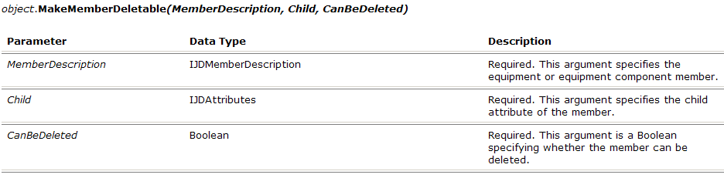
EquipCADHelper service
The Equipment Symbol CAD Helper service provides methods and properties to manage the custom assembly definition.
The MakeMemberDeletable method sets the Custom Assembly member deletable or non-deletable depending on the setting of the CanBeDeleted flag.
m_oEquipCADHelper.MakeMemberDeletable oMemberDescription, pIJDAttrs, CBool(varNewAttrValue)

Slide 81
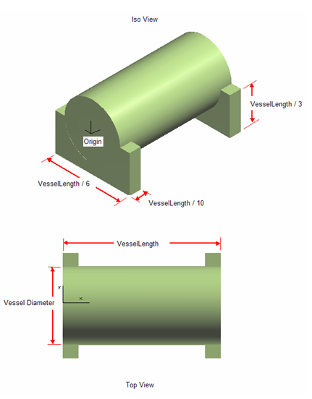
Equipment Component Assembly
Example: Equipment component without members

Slide 82
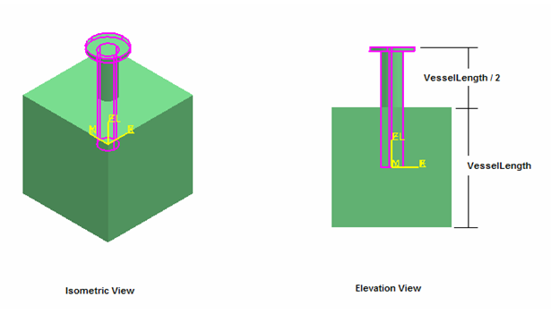
Equipment Assembly
Example: Equipment with nozzle placeholder

Slide 83
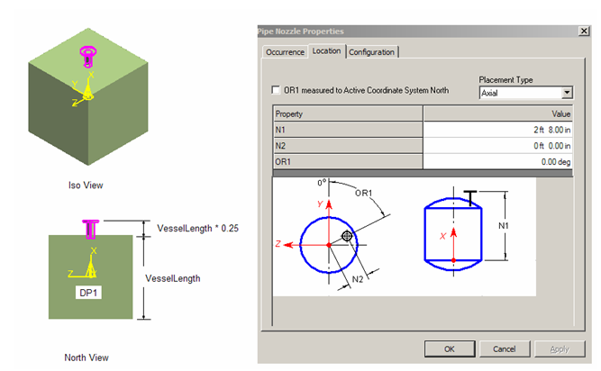
Equipment Assembly
Example: Equipment with pipe port created relative to a shape

Slide 84
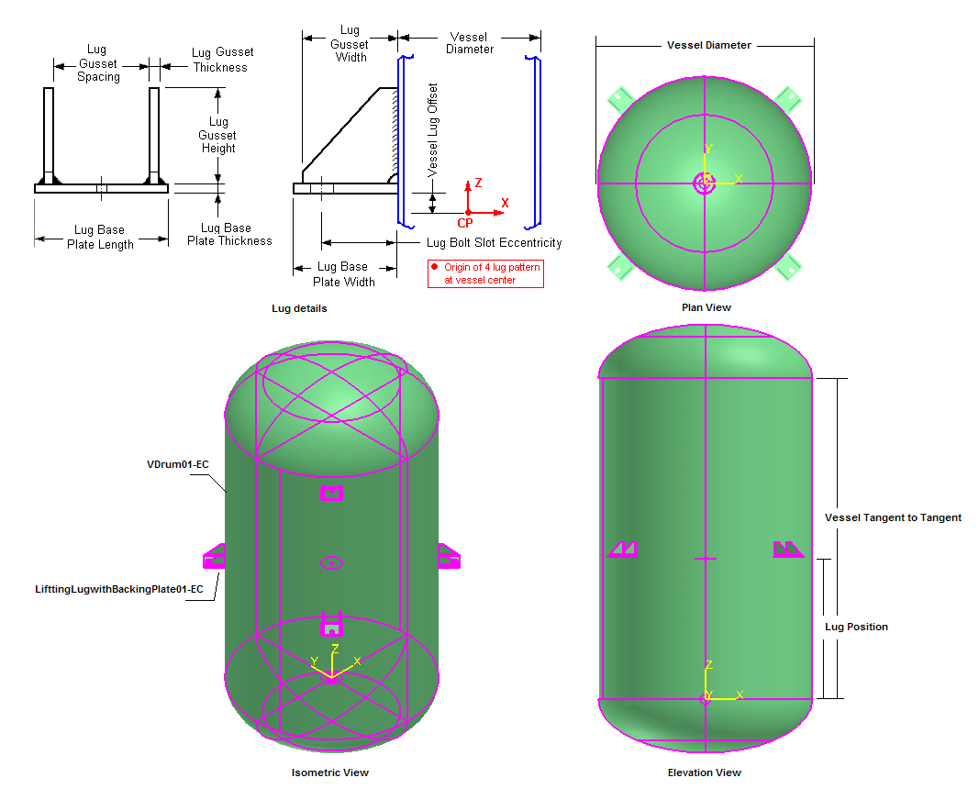
Equipment Assembly
Example: Equipment components as a member of the equipment assembly

Slide 85
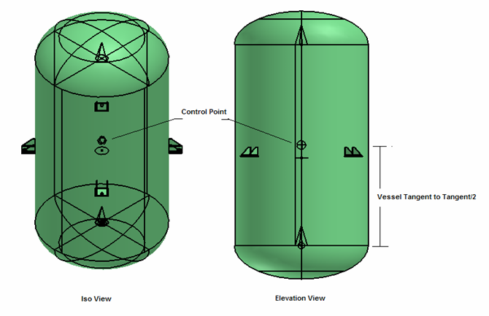
Equipment Assembly
Example: Control Point as member of the equipment assembly

Slide 86
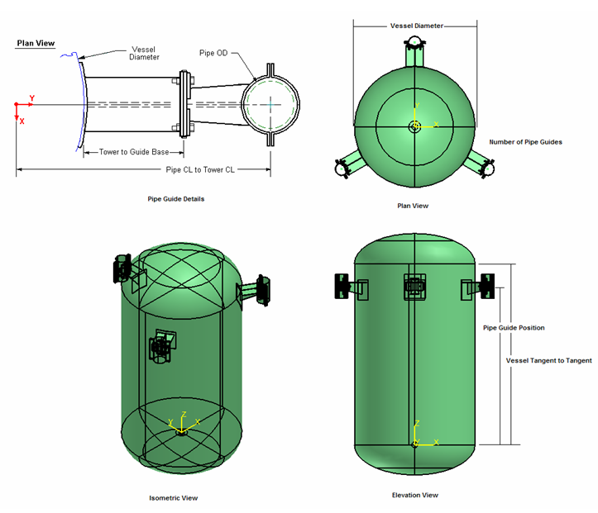
Equipment Assembly
Example: Variable members

Slide 87
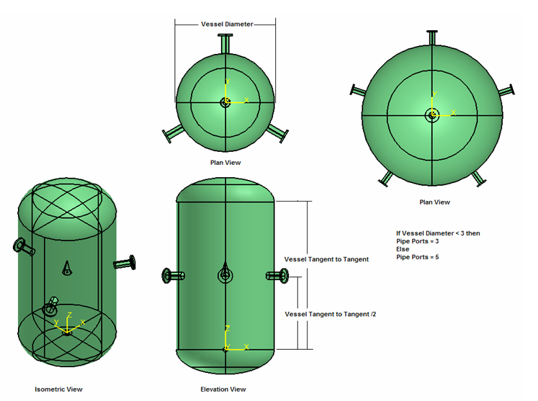
Equipment Assembly
Example: Variable members

